Slide 1
Risk Scoring & Prioritization System
AI/ML Intelligence Hackathon — Track 4
"Transforming transaction data into actionable investigation priorities."
Team: Descent Members: Anmol Shrestha, Amulya Shrestha

Slide 2
Problem Statement
RISK PRIORITIZATION
THE CHALLENGE
OUR GOAL
Financial institutions process thousands of transactions daily, making it impossible for analysts to investigate every account equally.
Develop an intelligent system that ranks threats and explains risk factors to optimize analyst investigations:
• Large transaction volumes • Limited investigation resources • High false-positive rates • Difficulty prioritizing suspicious accounts
✓ Predicts account risk Using machine learning transaction-level probability ✓ Ranks accounts by investigation priority Focusing operational resources on the highest-threat entities ✓ Explains why an account is considered risky Using SHAP explanations for full auditability and transparency
AI/ML Intelligence Hackathon — Track 4
Slide 2 of 10

Slide 3
Dataset Overview
AML RISK PRIORITIZATION
DATA SOURCE & SCALE
FEATURE CATEGORIES
100,000+
Transaction Features
• Amount • Currency • Cross-border activity flags
Transactions (ml_features.csv)
Target Variable: is_suspicious_tx Granularity: Transaction-level features aggregated to account-level
KYC Features
• PEP indicators • Sanctions indicators • Account age in days
KEY OBSERVATION
The dataset is highly imbalanced (suspicious activities represent a tiny fraction). Traditional metrics like accuracy are misleading. The model must be validated using PR-AUC (Precision-Recall Area Under Curve).
Behavioral Features
• Transaction velocity (rolling counts) • Amount variance over time
AI/ML Intelligence Hackathon — Track 4
Slide 3 of 10

Slide 4
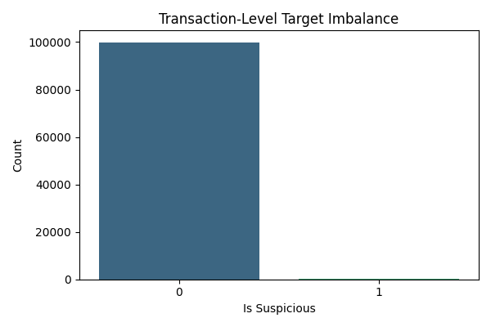
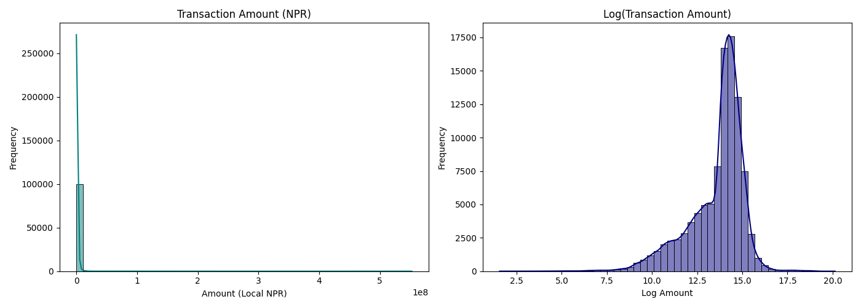
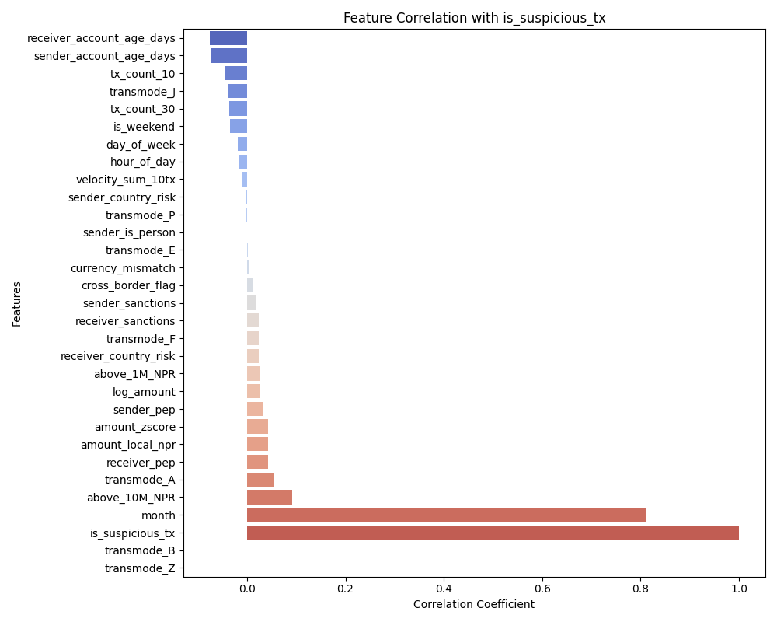
Exploratory Data Analysis
AML RISK PRIORITIZATION
KEY INSIGHTS
EDA VISUALIZATIONS
01
Cross-Border Spikes: Transactions crossing borders showed significantly higher suspicious activity rates.
02
Velocity Correlations: High transaction frequency and velocity were strongly associated with suspicious behaviour.
03
KYC Risk Flags: PEP and sanctions indicators contribute the most significant boost to risk probability.
Target Distribution Imbalance
Amount Distribution Profile
04
Amount Limitations: Large transaction amounts alone were insufficient indicators of risk without behavioral context.
Feature Correlation Heatmap
AI/ML Intelligence Hackathon — Track 4
Slide 4 of 10

Slide 5
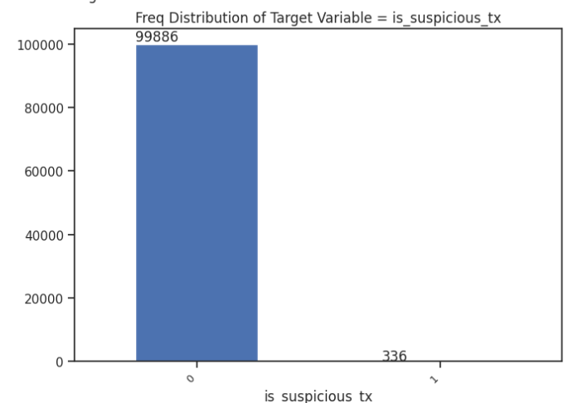
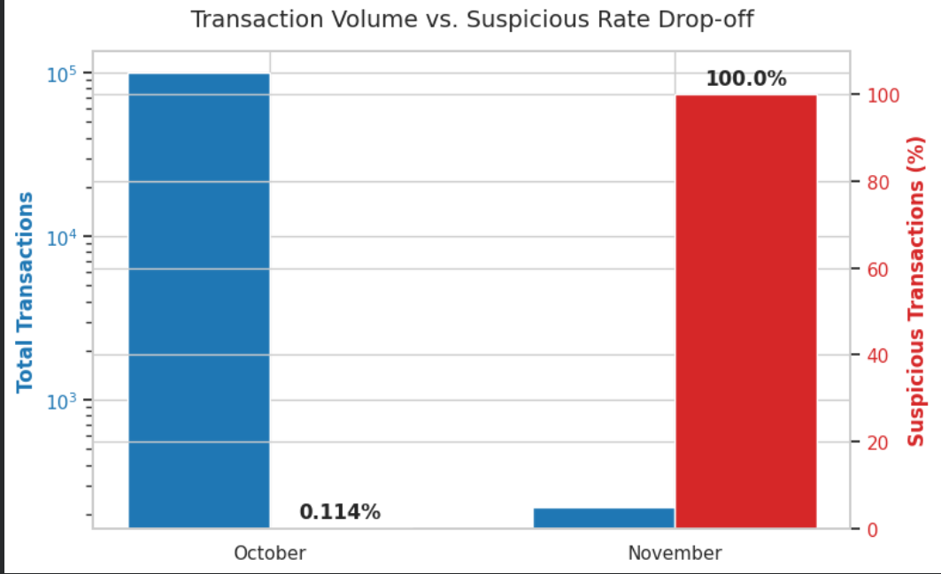
Some Important EDA findings
AML RISK PRIORITIZATION
Spike rise in the fraud transaction in November
Highly imbalanced dataset

Slide 6
Solution Architecture
AML RISK PRIORITIZATION
END-TO-END WORKFLOW PHASES
PHASE 1: PREDICTION
PHASE 2: PRIORITIZATION
PHASE 3: INVESTIGATION
1. Raw Transaction Data Inbound financial record stream 2. Feature Engineering Build velocity & risk signals 3. LightGBM Model Compute transaction probabilities
4. Account Aggregation Roll up predictions to account level 5. Risk Score Generation Calculate unified threat metric 6. Account Ranking Order entities by investigation priority
7. SHAP Explainability Calculate local risk drivers 8. Analyst Dashboard Streamlit UI for investigation 9. Operational Review High-priority entities processed
➔
➔
KEY DESIGN PATTERN: Rather than isolating transaction events, we aggregate signals to deliver account-level intelligence, helping compliance teams focus on macro behavior.
AI/ML Intelligence Hackathon — Track 4
Slide 5 of 10

Slide 7
Feature Engineering
AML RISK PRIORITIZATION
RISK SIGNALS ENGINEERED FOR MODELING
Behavioral Features
Amount Features
Risk Indicators
• Transaction velocity rolling sum of last 10/30 tx • Transaction frequency count of events in time window • Amount variance statistical deviation of sums
• Log-transformed amount stabilizes variance across levels • Amount anomaly score local sender Z-score metric • High-value flags threshold triggers (>1M, >10M)
• Country risk scores geographical exposure factor • Cross-border flags indicates outbound threat flow • PEP / Sanctions status regulatory blacklists match
These engineered features capture suspicious behavioral patterns that traditional rule-based systems (which check single thresholds) completely miss.
AI/ML Intelligence Hackathon — Track 4
Slide 6 of 10

Slide 8
Model Development
AML RISK PRIORITIZATION
LIGHTGBM CLASSIFIER APPROACH
VALIDATION STRATEGY
Models Evaluated: Random Forest vs. LightGBM Why LightGBM Chosen? • Handles Imbalance: Native class weighting resolves heavy skew. • Non-linear Capture: Tree splits capture complex multi-feature risk interactions. • High Efficiency: Sub-second batch inference over thousands of accounts. • Tabular Champion: Proven performance superiority on structured AML logs.
• Stratified Train-Test Split: 20% holdout sets preserved. • 5-Fold Stratified Cross-Validation: Ensures evaluation consistency, protects against target leakage, and reduces model variance.
EVALUATION METRICS
• PR-AUC (Precision-Recall Curve Area): Primary metric due to class imbalance. • Recall: Measures percentage of true fraud/suspicious accounts successfully flagged. • Precision@K: Reflects how many alerts are actual threats in the top K ranked alerts (crucial for analyst workloads).
AI/ML Intelligence Hackathon — Track 4
Slide 7 of 10

Slide 9
Risk Scoring & Ranking
AML RISK PRIORITIZATION
ACCOUNT-LEVEL PRIORITIZATION
EXAMPLE PRIORITIZED OUTPUT
Instead of viewing transaction logs as isolated events, we combine probabilities to prioritize investigation targets:
Rank | Account ID | Risk Score (0-100)
1 | 9000000000073 | 99.6
2 | 9000000000171 | 99.5
3 | 90000000005 | 93.8
1. Transaction Risk Inference Each transaction gets a risk probability. E.g., Tx A (0.91), Tx B (0.82), Tx C (0.74). 2. Account-Level Aggregation Predictions are rolled up using statistics (maximum transaction threat, count of high risk flags, average volumes) to create a unified Account Risk Score. 3. Prioritized Queue Accounts are sorted descending by Risk Score. Analysts process top entities first.
OPERATIONAL IMPACT
Instead of wasting cycles reviewing random or low-probability alerts, compliance teams can focus directly on the highest risk tiers. This shifts AML operations from reactive triage to proactive threat mitigation.
AI/ML Intelligence Hackathon — Track 4
Slide 8 of 10

Slide 10
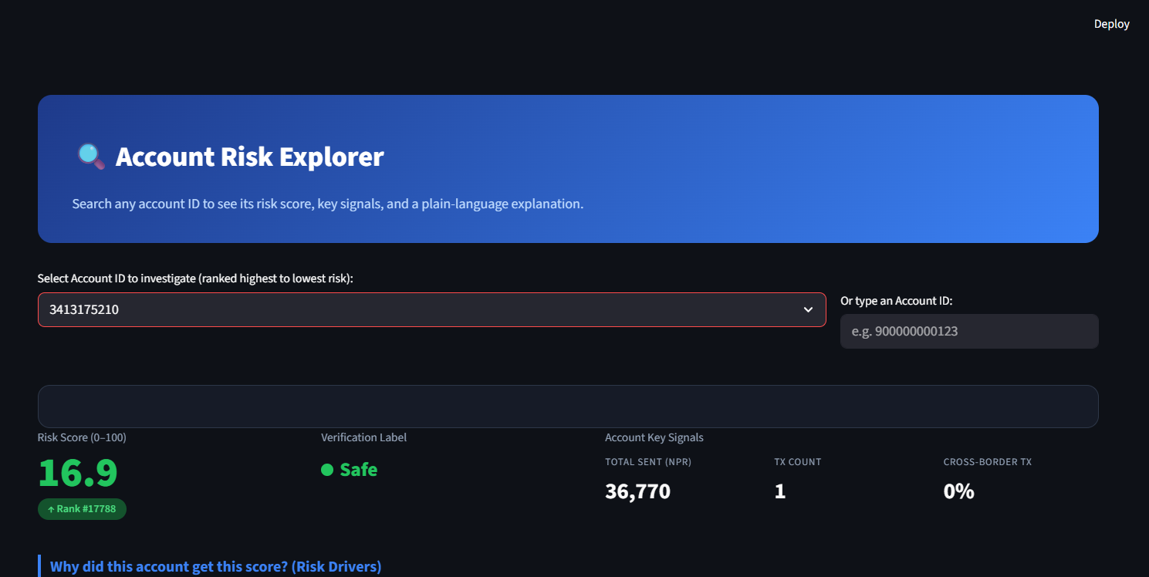
Explainability & Dashboard
AML RISK PRIORITIZATION
EXPLAINABLE AI (SHAP)
INTERACTIVE ANALYST DASHBOARD
SHAP explanations build regulatory trust by decomposing predictions into additive feature contributions:
SHAP THREAT ANALYSIS DETAILS
Target: Account 900000000073 Risk Score: 98 / 100 Top Driving Risk Factors: 1. Cross-border activity flag (+34.2% contribution to probability) 2. High transaction velocity (+21.5% contribution to probability) 3. PEP (Politically Exposed Person) indicator (+18.9% contribution to probability) 4. Amount anomaly score (sender Z-score) (+15.4% contribution to probability)
AI/ML Intelligence Hackathon — Track 4
Slide 9 of 10

Slide 11
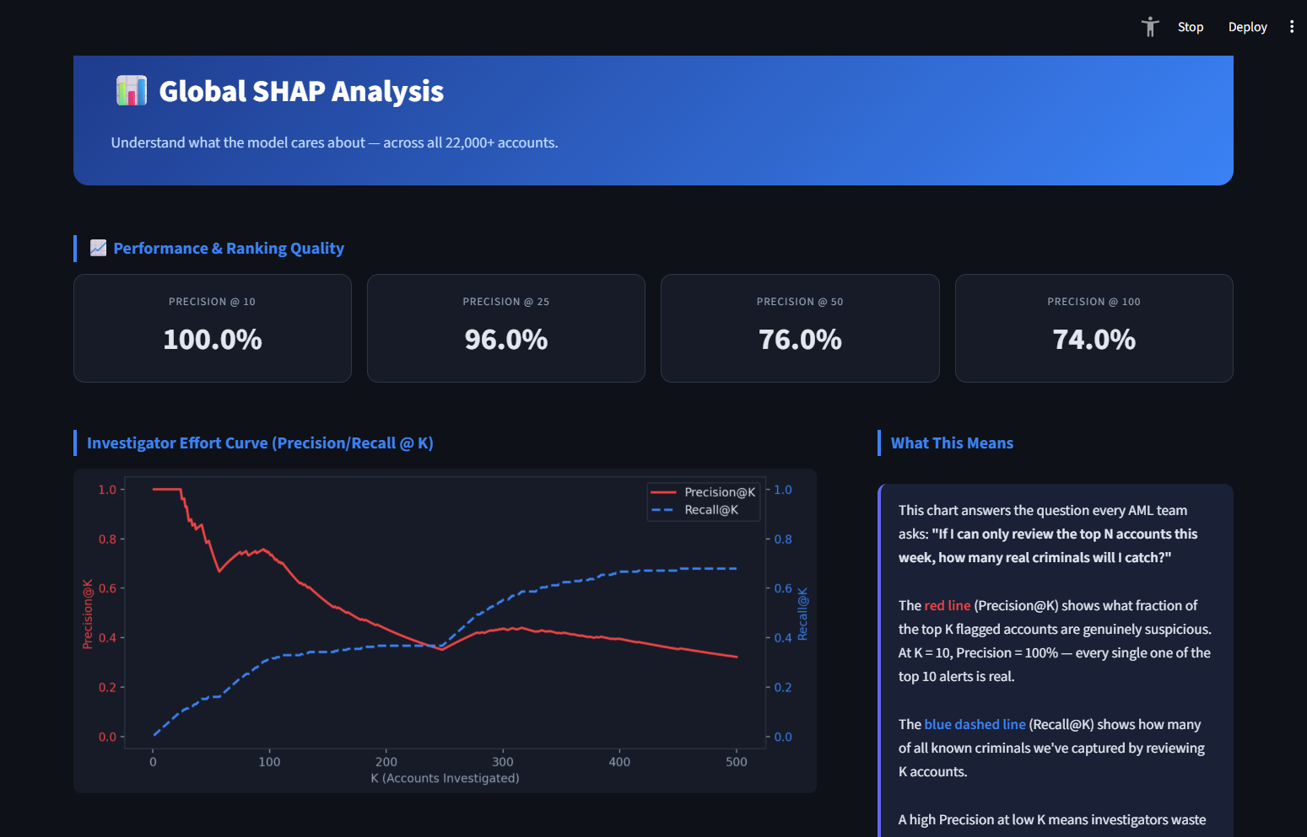
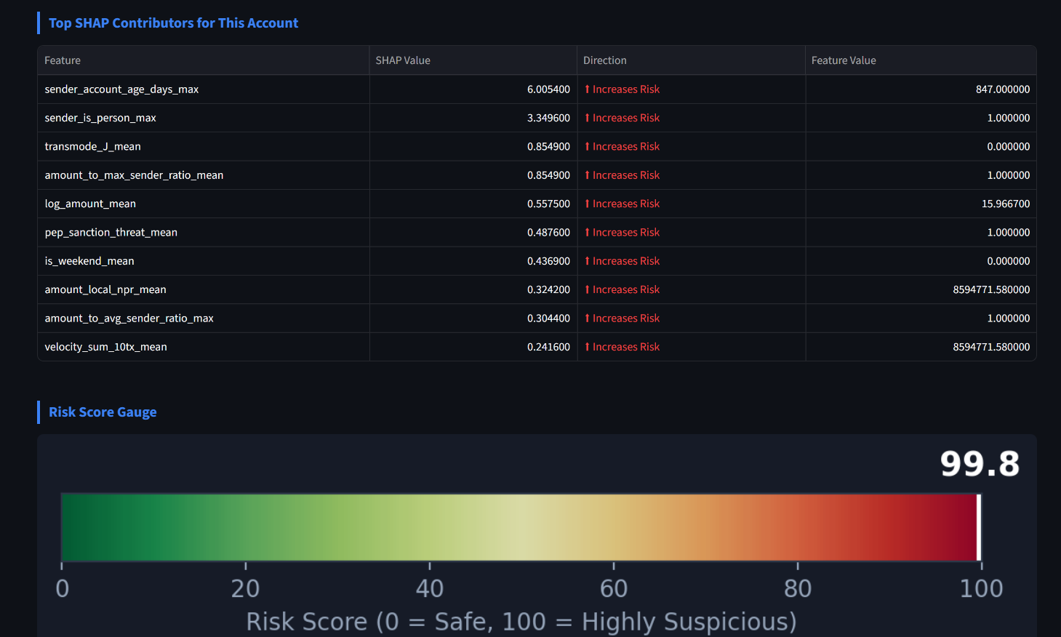
Dashboard Output
AML RISK PRIORITIZATION

Slide 12
Results & Impact
AML RISK PRIORITIZATION
BUSINESS IMPACT
MODEL PERFORMANCE METRICS
0.84%
✓ Prioritizes Highest-Risk Accounts Guides compliance officers directly to high-threat accounts first. ✓ Reduces Analyst Workload Dramatically limits investigative noise and false-positive cycles. ✓ Improves Investigation Efficiency Boosts speed-to-action by consolidating context (KYC & activity) in one spot. ✓ Provides Explainable Risk Assessments Fully compliant with model governance rules using clear SHAP outputs.
Out-Of-Fold PR-AUC
(Baseline Average Precision)
100.00%
Precision @ Top 50 Accounts
(100% of investigated alerts are true fraud)
21.10%
Recall @ Top 50 Accounts
(Catches 21.10% of total fraud by checking top 1% targets)
KEY TAKEAWAY: Our model delivers an analyst-ready AML prioritization framework combining risk prediction, ranking, and explainability.
AI/ML Intelligence Hackathon — Track 4
Slide 10 of 10

Slide 13
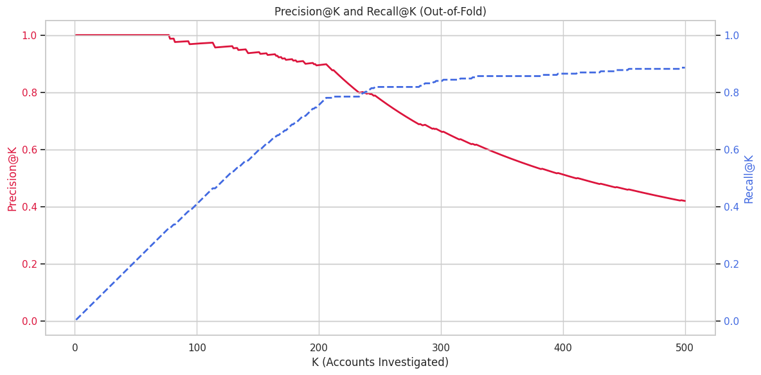
Visualizing PR AUC
AML RISK PRIORITIZATION

Slide 14
THANK YOU

